Slide 1
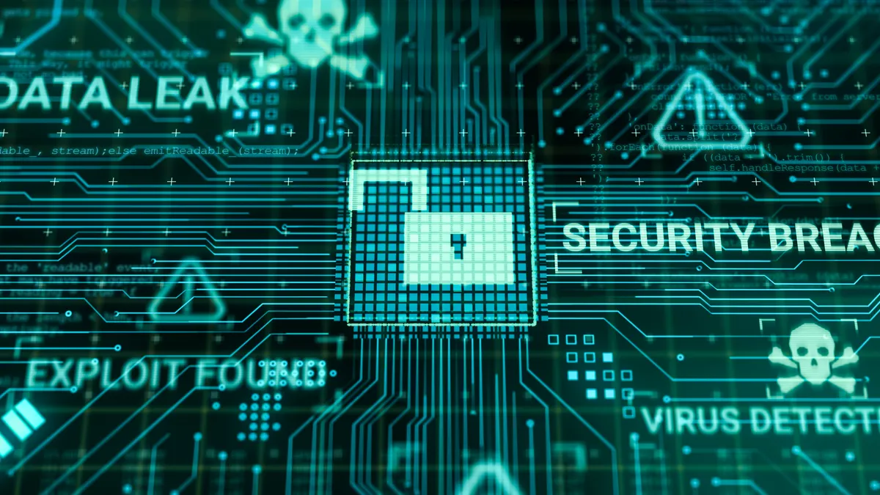
Understanding Data Breaches

Slide 2
Learning Outcomes
By the end of this lesson, students will:
Understand what a data breach is.
Know how data breaches occur.
Learn about notable examples of data breaches.
Explore ways to prevent them.

Slide 3
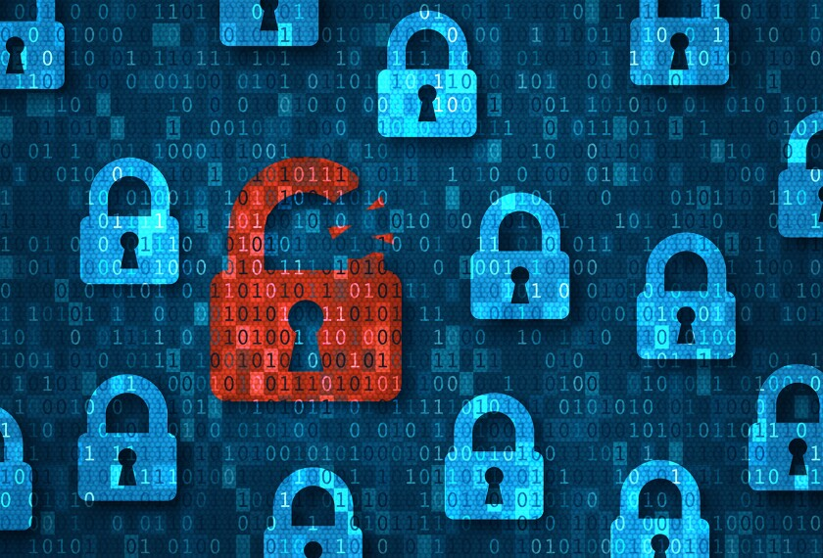
What is a Data Breach ?
A data breach happens when confidential information is accessed without permission. This information can be:
Personal data: like names, addresses, and phone numbers.
Financial information: like credit card numbers or bank details.
Account credentials: usernames and passwords.
Once this data is exposed, hackers can use it for identity theft, fraud, or selling it on the dark web.
Data breaches can happen to individuals, businesses, and even governments.

Slide 4
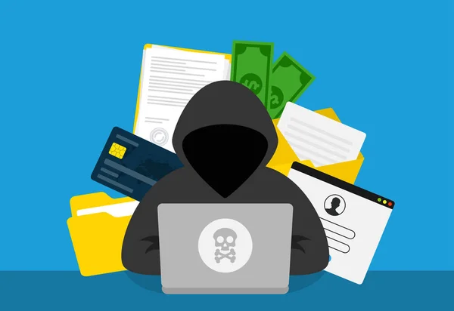
Types of Data at Risk
In a data breach, several types of data can be stolen, including:
Personally Identifiable Information (PII): Your name, home address, phone number, and social security number.
Financial Information: Credit card numbers, bank accounts, and other financial details.
Medical Information: Health records, insurance details.
Passwords and Account Info: Email addresses, usernames, and passwords.
Each of these data types is valuable to cybercriminals and can be used to commit fraud or identity theft.

Slide 5
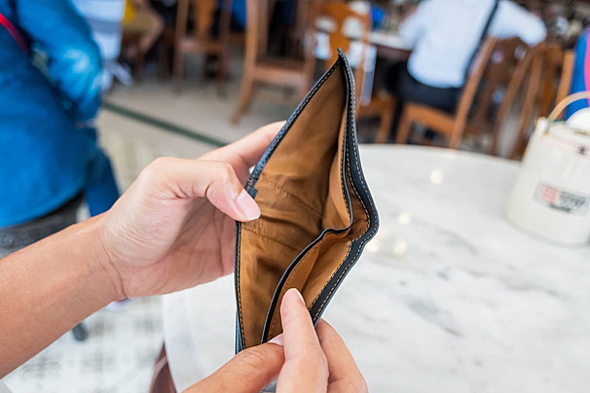
Why Do Data Breaches Matter ?
Data breaches can lead to:
Identity theft: When someone pretends to be you to access your bank account or open new credit cards.
Financial loss: If a hacker steals your credit card details, they can make purchases in your name.
Damage to reputation: For businesses, losing customer data can damage their reputation and lead to loss of trust.
Legal consequences: Some companies must pay fines or face legal action when they fail to protect data properly.

Slide 6

How Do Data Breaches Happen ?
Data breaches occur in several ways, including:
Weak passwords: Hackers use software that can guess common or weak passwords.
Phishing attacks: Emails or messages tricking people into giving away their personal information.
Malware: Hackers use malicious software to break into systems and steal data.
Unprotected systems: Computers or software that aren’t updated or secured properly can be easy targets.
Insider threats: Sometimes, employees accidentally or intentionally cause breaches.

Slide 7
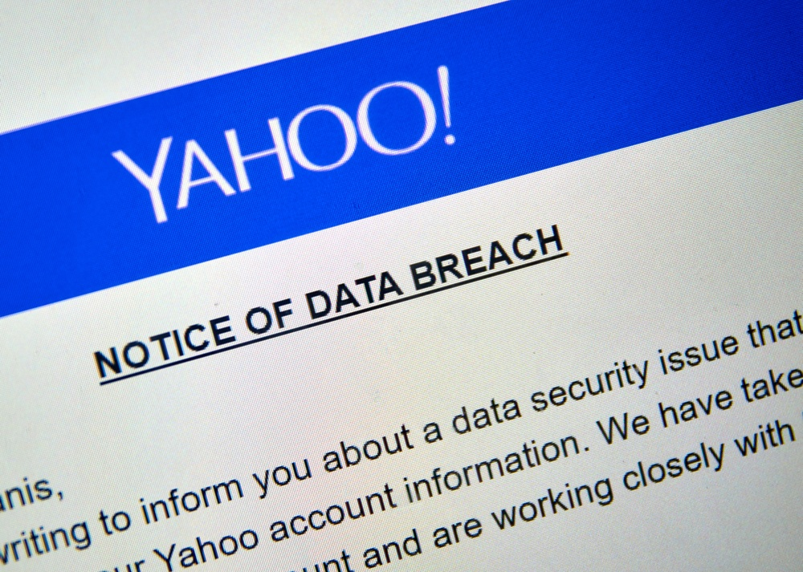
Yahoo Data Breach (2013)
One of the biggest data breaches in history happened to Yahoo in 2013.
Hackers stole data from 3 billion accounts, including email addresses, passwords, and answers to security questions.
This made it easy for hackers to access other accounts of users who reused the same passwords.
Consequences:
Yahoo lost millions of dollars in the fallout.
It took them years to admit the full extent of the breach.

Slide 8
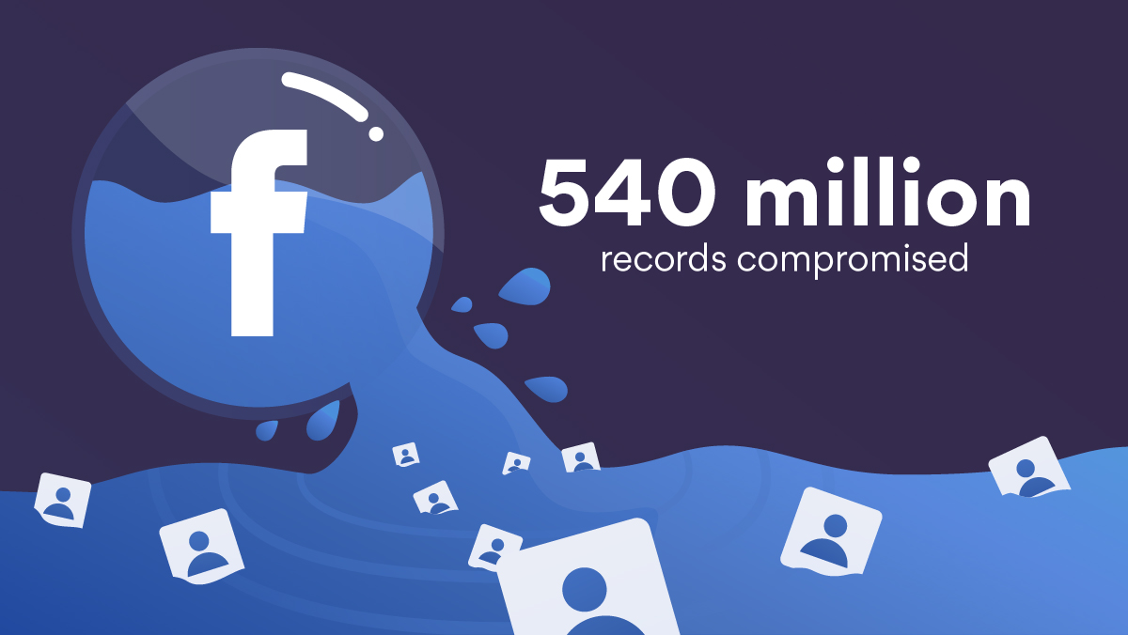
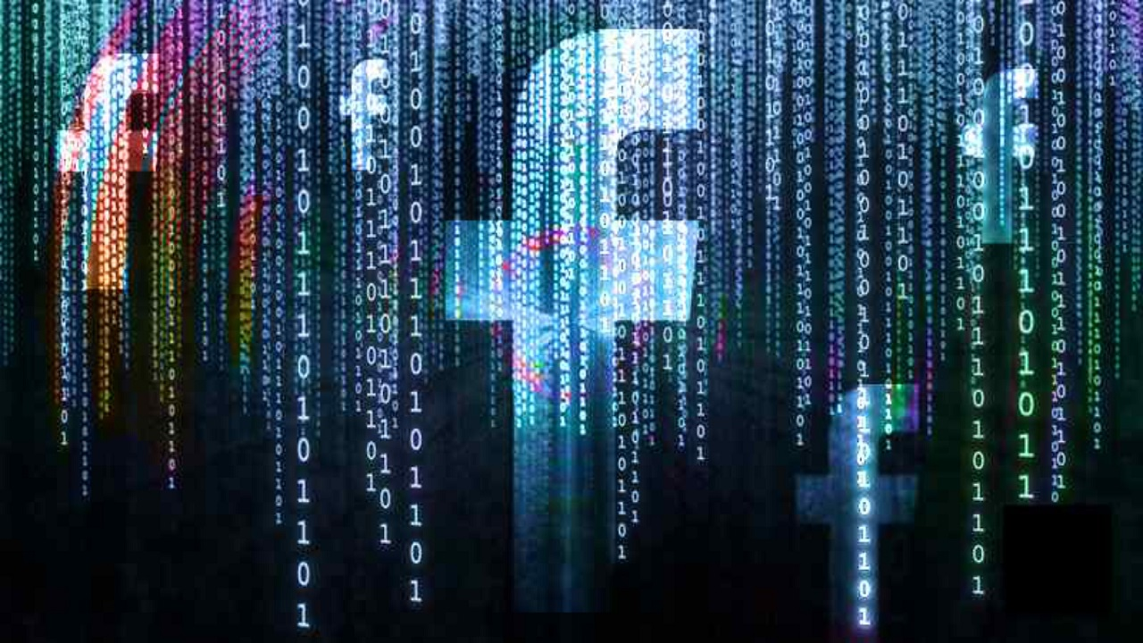
Facebook Data Breach (2018)
In 2018, Facebook faced a major breach affecting 50 million users.
Hackers found a vulnerability in Facebook’s code, which allowed them to take over user accounts without needing a password.
Consequences:
The breach damaged Facebook’s reputation and raised concerns about user privacy.
The company had to fix the vulnerability and offer more security features for users.

Slide 9
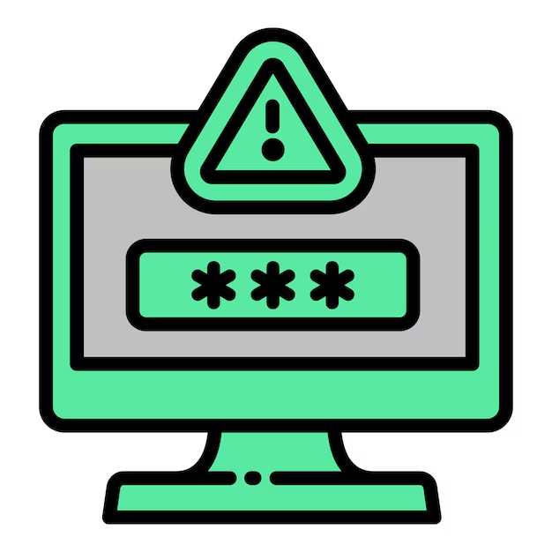
Common Causes of Data Breaches
Weak Passwords: People often use simple passwords like "123456" or "password," which can be easily guessed by hackers.
Phishing Attacks: Emails that look like they’re from trusted companies trick people into giving away their data.
Unsecured Websites: Websites without security (HTTPS) can expose user data to hackers.
Unpatched Software: Outdated software can have vulnerabilities that hackers exploit.
Reused Passwords: Using the same password for multiple accounts can lead to multiple accounts being hacked if one is breached.

Slide 10
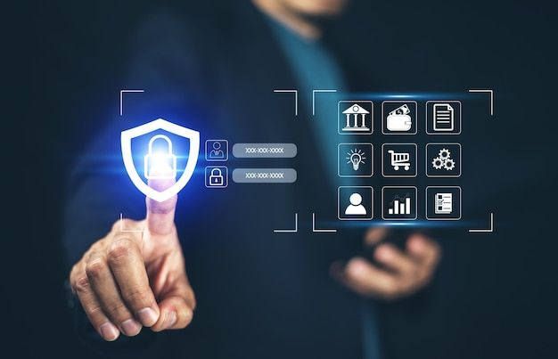
Protecting Yourself from Data Breaches
Use Strong Passwords: Make passwords long and complex by using a mix of letters, numbers, and symbols.
Enable Two-Factor Authentication (2FA): Add an extra layer of security by receiving a code on your phone or email to log in.
Be Aware of Phishing Scams: Always double-check email addresses and links before clicking.
Use Secure Websites: Ensure the website has HTTPS and a padlock symbol in the address bar.
Update Software Regularly: Security patches fix vulnerabilities, so always update when asked.

Slide 11
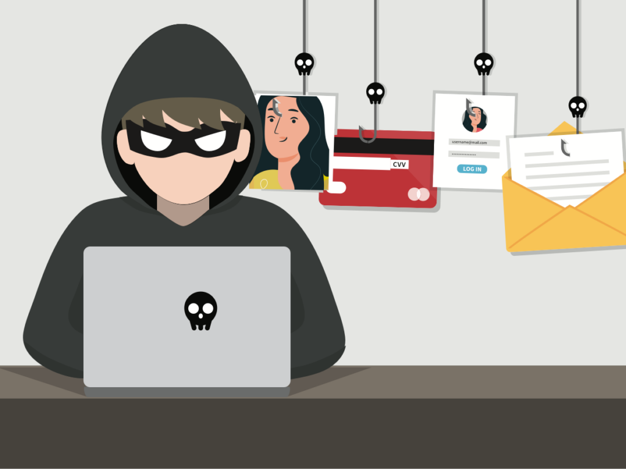
What is Phishing ?
Phishing is when cybercriminals trick you into revealing personal information by pretending to be someone you trust, like:
Your bank or a well-known company.
They may send you an email or a text message with a link to a fake website.
If you enter your details on the fake website, hackers can steal your information.
Example: You receive an email saying your bank account has been compromised and asking you to click a link to verify your identity. The link leads to a fake website.

Slide 12
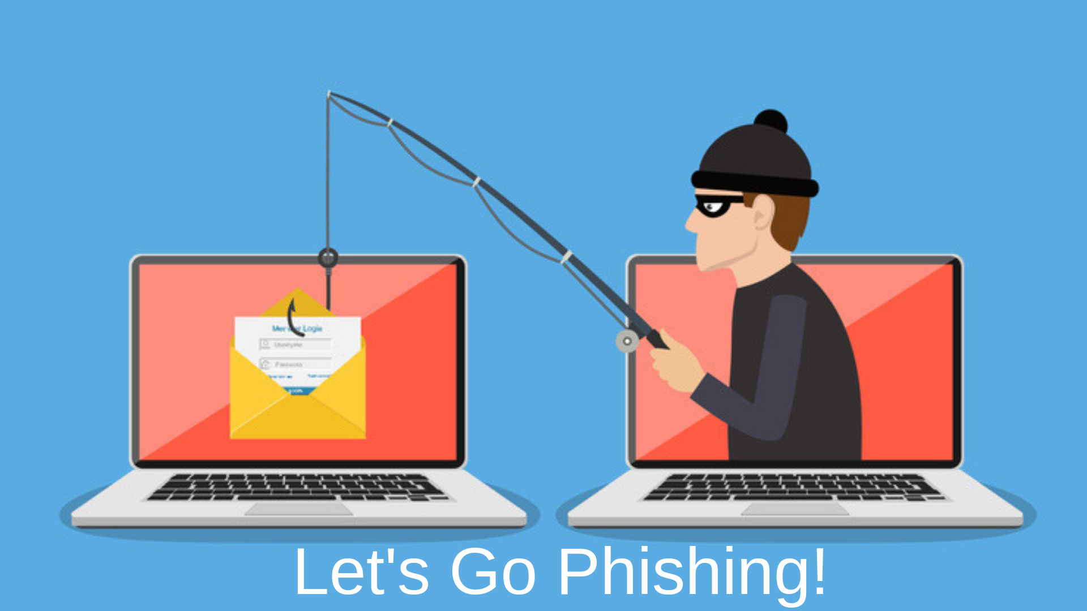
How to Spot Phishing Emails
Look for these warning signs:
Spelling mistakes or awkward wording.
Urgent requests to update your account or provide sensitive info.
Email addresses that don’t match the company name (e.g., a Gmail address from a company).
Suspicious links: Hover over the link to see the actual URL. Does it look legitimate?

Slide 13
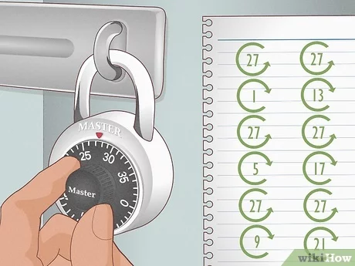
Password Security Best Practices
To protect your data, follow these tips:
Create strong passwords: At least 12 characters long, including uppercase, lowercase, numbers, and symbols.
Use different passwords for each account.
Consider using a password manager to store and generate strong passwords.
Change passwords regularly, especially if you think your account may have been compromised.
Don’t share your password with anyone, and avoid writing it down where it can be easily found.

Slide 14
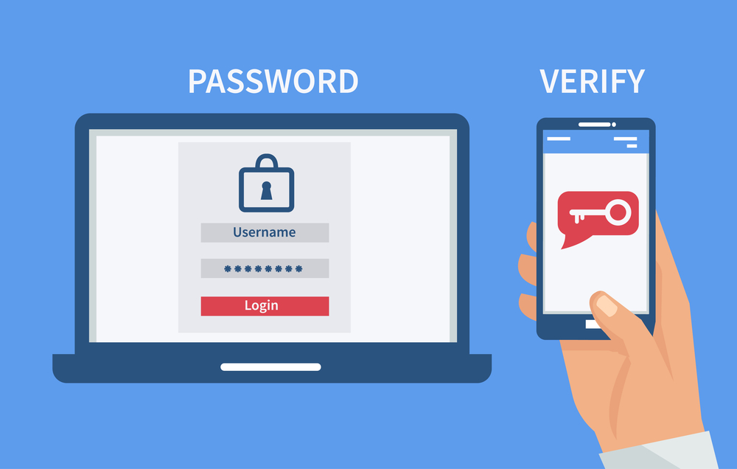
Two-Factor Authentication (2FA)
Two-factor authentication adds an extra layer of security to your accounts by requiring:
Something you know (your password).
Something you have (a phone, email, or security key).
Even if someone steals your password, they still can’t access your account without the second factor.
Many apps and websites, like Gmail, Facebook, and Instagram, offer 2FA as an option. Always turn it on!

Slide 15
What to Do If You Are Breached
Act quickly if you believe you’re the victim of a data breach:
Change your passwords immediately for the affected accounts.
Enable 2FA if it’s not already on.
Check for any suspicious activity on your accounts (unfamiliar transactions, new devices).
Contact your bank or credit card company if your financial details are at risk.
Monitor your email for alerts about new logins or password changes.

Slide 16
Case Study: Equifax Data Breach (2017)
The Equifax breach exposed personal data (like social security numbers, credit card numbers) of 147 million people.
Cause: An unpatched vulnerability in their web application.
Consequences: Millions of people were at risk of identity theft. The company paid $700 million in fines and compensation.
Lesson: Always keep software updated to avoid leaving vulnerabilities open for attack.

Slide 17
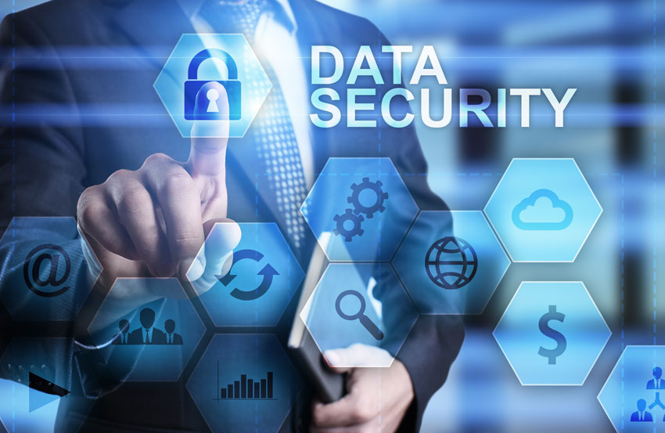
Future of Data Security
As technology evolves, so do the methods that hackers use to breach data. However, new technologies are emerging to fight back:
Artificial Intelligence (AI): Helps detect and prevent breaches before they happen.
Blockchain technology: Could improve data security by making transactions more transparent and harder to tamper with.
Biometric authentication: Fingerprints, facial recognition, and other forms of identification are becoming more common.

Slide 18
Quiz: Test Your Knowledge
Let’s test what you’ve learned! Try answering these questions:
What is a data breach?
What are some common causes of data breaches?
How can you protect yourself from phishing attacks?
What is two-factor authentication, and why is it important?

Slide 19
Conclusion and Final Thoughts
Data breaches are serious issues that can affect anyone, from individuals to large companies.
By using strong passwords, two-factor authentication, and being cautious about phishing scams, you can better protect your personal data.
Remember, staying informed and vigilant is the key to keeping your information safe.

